Slide 2

Exploratory Data Analysis
- Research Domain Knowledge Data
- Understanding Every Feature in Data
- Check Data Properties
- Check Missing Value
- Visualization Data
- ETC

Slide 3
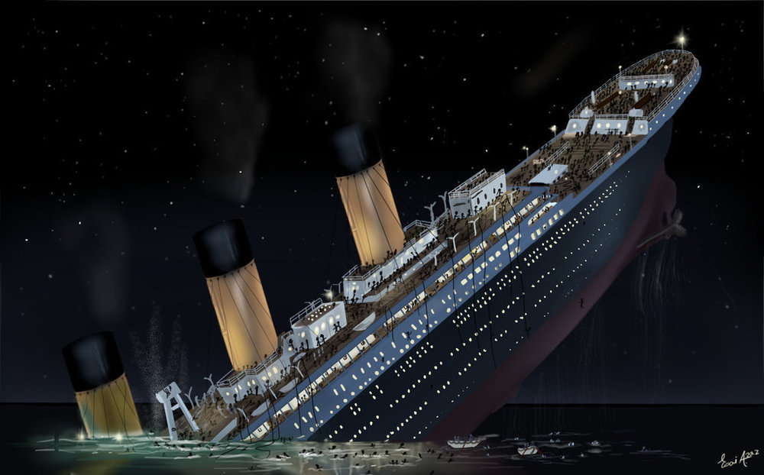
EDA: Research Domain Knowledge
Titanic Kapal Super Britania Raya yang Tenggelam karena menabrak sebuah gunung es di Samudra Atlantik Utara Pada 15 April 1912 dan Mengakibatkan Kematian 1.514 Penumpang

Slide 4
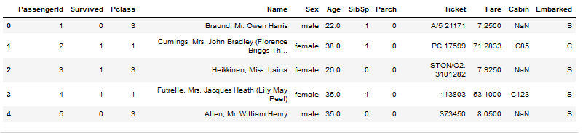
EDA : Understanding Every Feature in Data

Slide 5
EDA : Understanding Every Feature in Data
- PassengerId = Id Penumpang
- Survived =
0 = No (Meninggal),
1 = Yes (Hidup)
- pclass: Ticket class 1 = 1st, 2 = 2nd, 3 = 3rd
- Name = Nama dari setiap penumpang
- Sex = Jenis Kelamin Penumpang
- Age = Umur dari penumpang
- Fare = Tarif

Slide 6
EDA : Understanding Every Feature in Data
- Sibsp of siblings / spouses = Jumlah saudara atau Pasangan
- Parch: of parents / children= Jumlah Orang tua atau anak
- Ticket: Ticket number
- Cabin: Cabin number = Nomor Kamar di kapal
- Embarked:Port of Embarkation / Pelabuhan Pemberangkatan
C = Cherbourg,
Q = Queenstown,
S = Southampton

